Slide 1
Project 4: Loan Charge Offs and Related Variables
Group Members: Ryan Lund, Hamid Nazari, Cristian Guerrero, Lu Ye, Joseph Gonzalez and Stephanie Patrica Anshell
11-16-2023

Slide 2
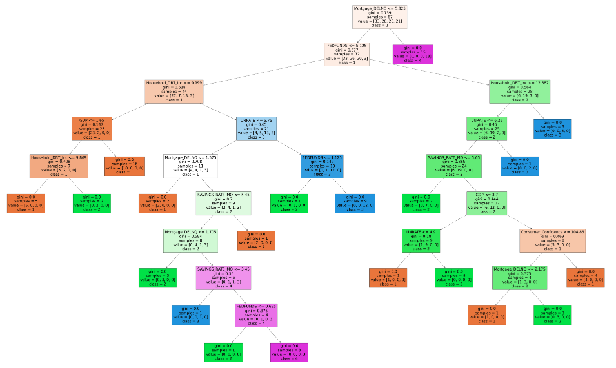
Project 4 Introduction
Project 4 explores the relationship between 4 types of loan charge offs and variables that may contribute to loan charge offs.
A loan charge off occurs when a bank can no longer collect an outstanding loan balance. This represents a loss to the bank.
Charge offs typically increase during economic recessions when metrics such as the unemployment rate and delinquent loan payments increase.
In our experimental design, loan charges offs are our dependent variables and independent variables include economic metrics and loan related metrics.
We chose 4 different groups of loans to test: Credit Cards, Mortgages, C&I (business) loans and CRE (Commercial Real Estate) loans.
We primarily used four different machine learning methods to test our data: Decision Trees, Random Forests, Logistic Regressions and Deep Learning Networks.

Slide 3
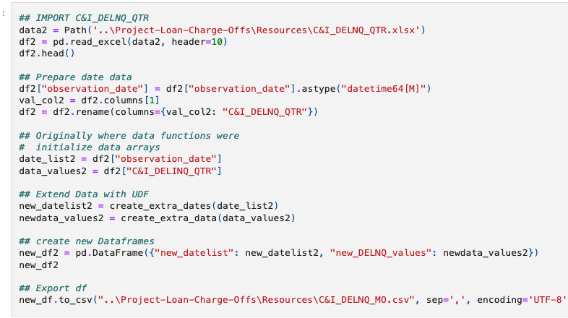
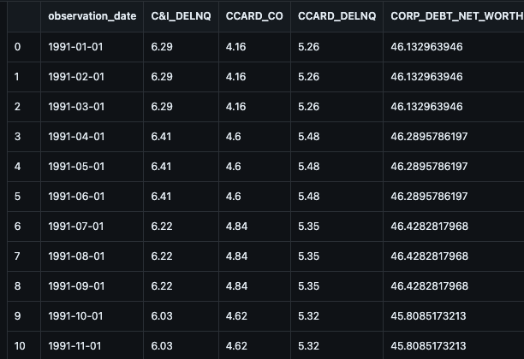
Extract, Transform and Loan (ETL)
The data for Project 4 was exclusively obtained from the Federal Reserve Economic Database (‘FRED’) maintained by the Federal Reserve Bank of St. Louis.
Approximately 20 different variables were chosen to form the 4 loan charge off groups for Project 4. Some variables were reused in all the groups (such as unemployment rate) while other variables were unique to each group.
Overall, there was approximately 9 to 10 independent variables for each group.
The majority of the data obtained from FRED was presented on a quarterly basis while some of the data was presented on a monthly basis. It is not unusual for some economic variables (such as GDP) to be reported on a quarterly basis.
In order to maintain the maximum amount of data, quarterly data was transformed into monthly data with a loop.
In total, the final dataset had approximately 390 rows and dated back to 1991.

Slide 4
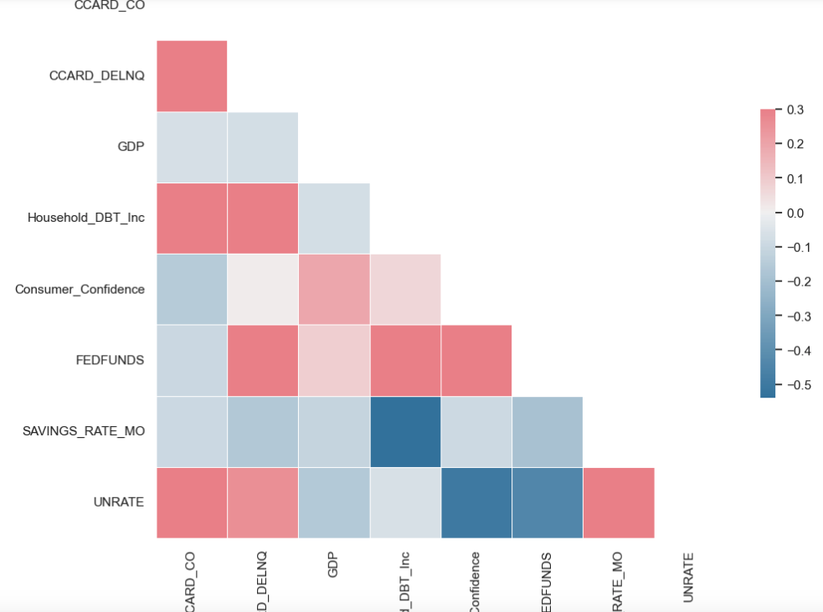
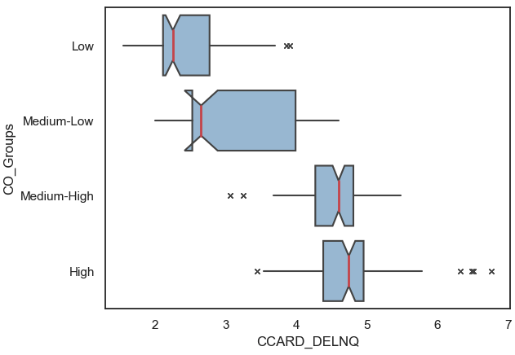
Correlation Matrixes and boxplots
A correlation matrix was created with Seaborn for each loan group. The correlation matrix was the first attempt to visualize the relationship between the variables.
The colors of the correlation matrix corresponded to the strength and direction of the correlation: Darker colors indicated stronger correlations with Red signifying a positive correlation and blue indicating a negative correlation.
For example, The correlation matrix shown here indicates a strong positive correlation between credit card charge offs and delinquencies, household-debt-to-income, and the unemployment rate.
All four loan groups demonstrated positive correlations with delinquencies and the unemployment rate.
The box plot for credit cards was organized into 4 quartiles of charge off risk and showed a strong positive correlation between delinquencies and credit card charge offs.

Slide 5
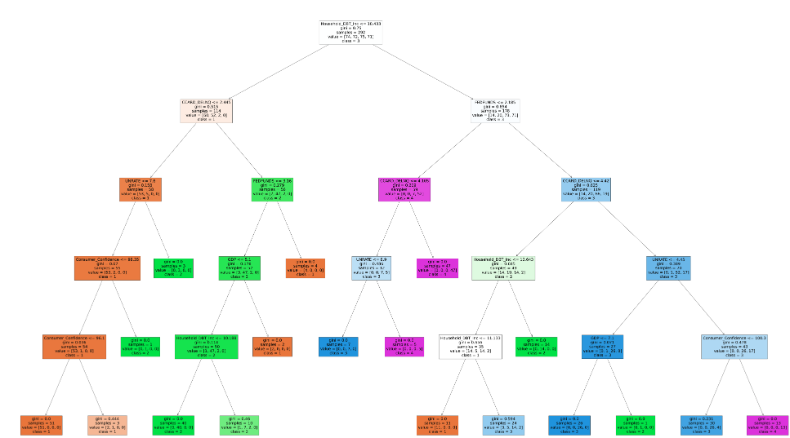
Decision and Random Forest Trees
Decision Trees and Random Forest Trees were amongst some of the highest scoring machine learning models tested in Project 4. For example, the credit card Decision Tree shown here reported a 93.9% accuracy score. Consider the following connection between the variables shown in the Tree:
Along the right branch of the tree, if Household-Debt-to-Income Ratio is above 10.43% and the Fed Funds Rate is above 2.19% and delinquencies are above 4.42% and the unemployment rate is above 4.45% and Consumer Confidence index is above 100.3, then the result is class 4 risk of charge off which signifies the highest quartile of credit card charge off risk.
This branch describes the relationship between several variables in the model: a higher Fed Funds rate could make the Household debt to Income ratio higher indicating a higher load of debt. This increased debt load could strain household income and increase the risk of delinquent loan payments. In turn, a higher unemployment rate could cause the risk of delinquent loan payments to go up as there are less jobs available to earn income which is needed to pay make loan payments. Finally, Consumer Confidence could be a leading or lagging indicator for increased credit card charge off risk in the model.

Slide 6
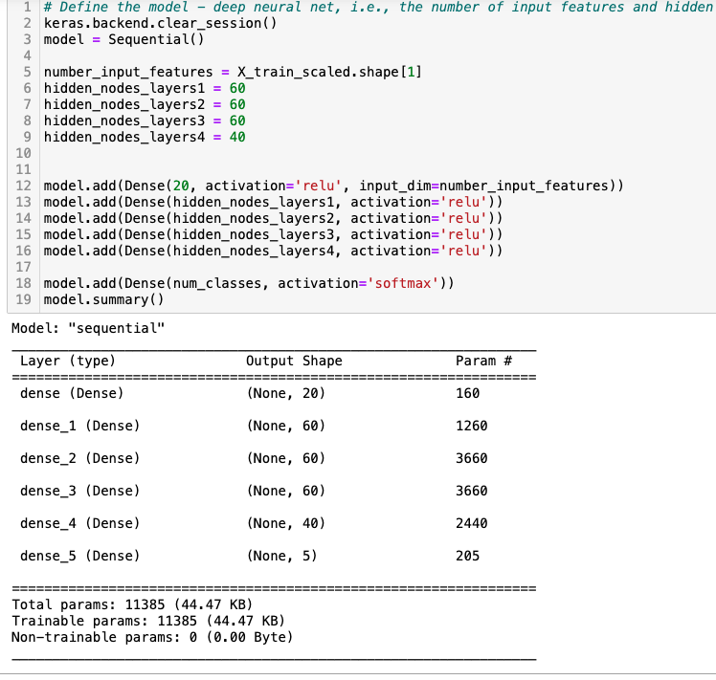
Neural Networks and Deep Learning
Deep Learning models were made for all 4 Loan Groups with the same model design.
For example, the credit cards group reported a 92.9% accuracy score and had the following design characteristics:
4 layers of hidden nodes with 60 nodes for the first 3 layers and 40 nodes for the 4th layer,
The activation type for the 4 hidden layers was ‘relu’,
The activation type for the final layer was ‘softmax’,
There were 200 epochs for the calculation.
The accuracy scores varied from loan group to loan group. Credit cards had the highest accuracy score while the C&I group had the lowest at 74.5%.
Overall, it appears that the Deep learning model did better with Consumer type loans (Credit Cards and Mortgages) versus Commercial type loans (C&I loans and CRE loans).

